Slide 1


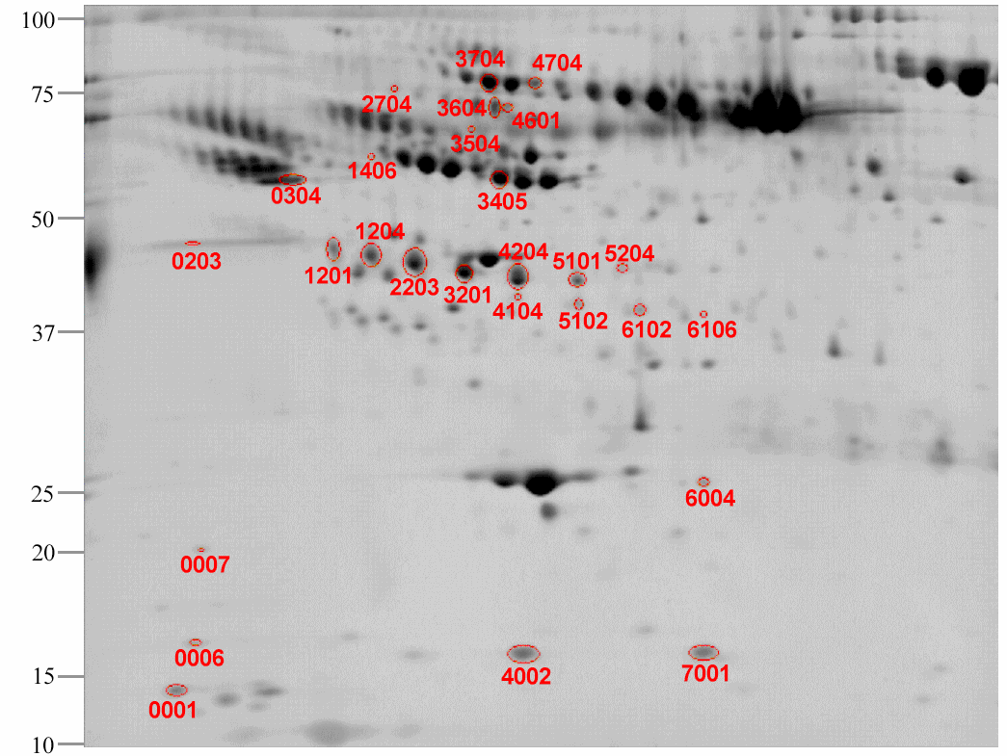
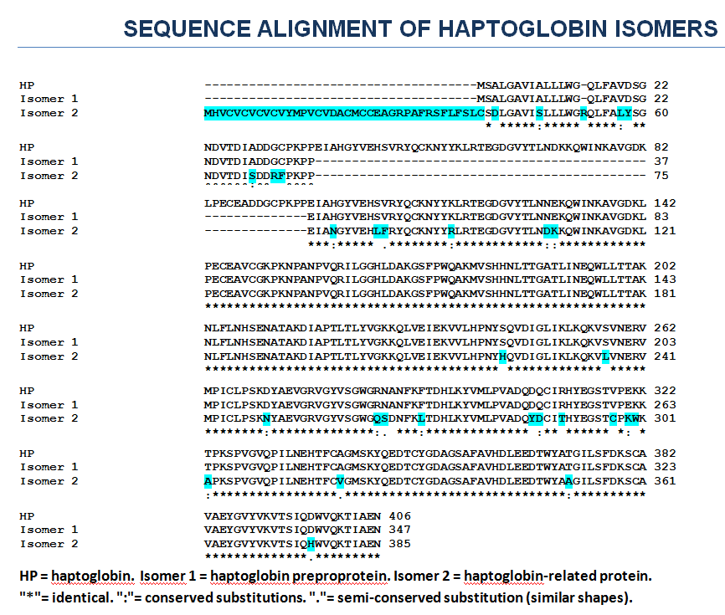
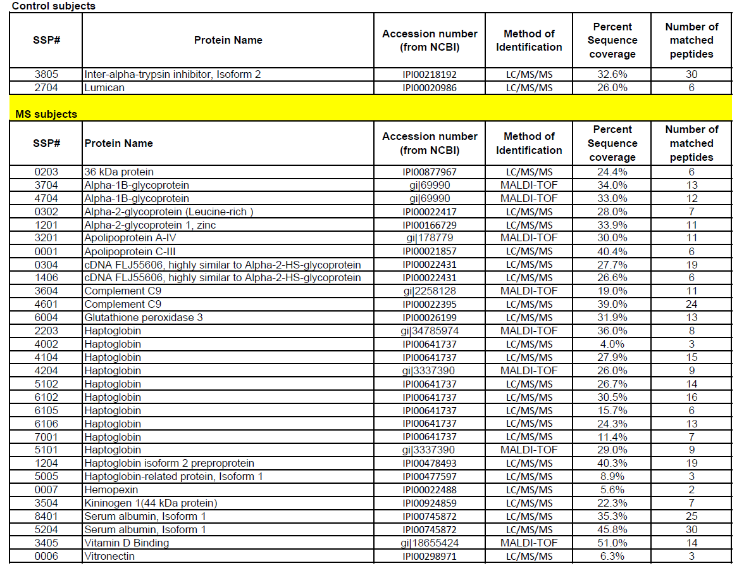
Novel Biomarkers in Pediatric MS Using Proteomics
Rithidech K.¹, Reungpatthanaphong P.¹, Honikel L.¹, Milazzo M. ², Waubant E.³, Krupp LB.²
¹Stony Brook University Medical Center, Stony Brook NY – Department of Pathology
²Stony Brook University Medical Center, Stony Brook NY – Department of Neurology
³University of California, San Francisco CA – Department of Neurology
Specific Aims
Results
pl
4
7
MW
(kD)
To determine if the pattern of protein-expression profiles in pediatric multiple sclerosis (MS) differs from age matched healthy controls (HC) and other medical disease controls(OMD).
To identify a subset of MS specific proteins in plasma not seen in controls HC which could serve as predictive biomarkers of the disease.
Shown in figure 1 is the master gel of proteins
As shown in figure 2, different sequences of haptoglobin isoforms 1 and 2 were detected in the MS but not in the control subjects.
There were increases in expression levels of several other proteins which included the precursor to Vitamin D binding protein, transthyretin.
Our method also allowed detection of important low abundance proteins which had an increased expression level in pediatric MS (including vitronectin, glutathione peroxidases) and decreased level (lumican) relative to OMD and HC.
Background
Proteomics has great potential for identifying early biomarkers of disease states and could offer a sensitive diagnostic tool for MS. A particularly attractive feature is that proteomics can be applied to the plasma of affected patients providing a relatively non-invasive and highly feasible approach. The advent of gel-image analysis software (e.g. PDQuest) has revolutionized two dimensional electrophoresis (2DE) gel based technology. Once novel or statistically different levels of protein expression are found they can be subjected to mass spectrometry for protein identification, which might lead to improved diagnosis and prognosis. Previously we had identified 12 proteins from the serum which differed in expression in MS relative to HC. However, we have further improved the sensitivity of our proteomics approach for the detection of low abundance proteins and we have expanded our studies to include a medical control group in addition to HC. Herein we report the results of our proteomic approach designed to detect low abundance proteins and describe MS specific findings relative to other medical controls.
Figure 1. Image of a representative 2D master gel from the MS group (n=6 ped ms pts). All labeled spots were more highly expressed in the MS samples relative to either healthy or OMD controls. See Table 1 for the proteins corresponding to each SSP#.
Figure 2. Comparison of sequences of wild-type haptoglobin (HP) , haptoglobin isoforms 1 and 2.
Table 1. Protein exhibiting significant alterations in levels of expression between HC and pediatric MS subject (Student’s t test (p<0.05)).
Discussion
Haptoglobin is an acute phase protein and plays a role in inflammation. We have detected two novel isomers of haptoglobin, i.e isomer 1 (haptoglobin preproprotein) and isomer 2 (haptoglobin-related protein) that were specific for pediatric MS relative to HC and OMD and could potentially serve as circulating biomarkers of pediatric MS. The identification of these isomers suggests potential post-translational modifications which differ between pediatric MS and controls, an area of research we are currently pursuing.
Finding highly expressed vitronectin is intriguing as it has been found in blood vessels, demyelinated axons, and astrocytes within active demyelinating MS lesions. Vitronectin also activates microglia and upregulates matrix metalloproteinases-9 (MMP9) which may significantly contribute to MS pathogenesis. Previously, vitronectin receptor has been identified in the sera of subjects with MS. In contrast, this is the first study to our knowledge in which the circulating vitronectin has been detected. Others have also detected expression of glutathione peroxidase 3 in serum of patients with RR MS; glutathione peroxidase 3 could be related to the presumed oxidative stress associated with the MS lesion.
Methods
Subjects:
Age matched pediatric MS (n=6);HC (n=4), and OMD controls (n=4) including:
one somatoform disorder, two mitochondrial disorders, and one with a cardiovascular disorder.
Proteomics:
Serum from subjects is depleted of 20 high abundance proteins so that low abundance protein proteins can be detected.
Long range 2D gels were used to separate proteins by pI and MW.
Normalization (using log transformation) of the data prior to statistical analysis which optimizes the reliability of the comparison of protein expression levels from protein spots among MS, HC and OMD control groups.
Application of the LTQ XL ion trap mass spectrometry for protein identification. The LTQ XL ion trap is a powerful tool for protein identification and characterization due to its capabilities of high resolution, rapid scan, and its excellent mass accuracy in a robust manner even within HPLC time scales.
Conclusions
MS specific proteomic profiles were detected among pediatric MS subjects, HC and OMD which can lead to the identification of a biomarker specific to pediatric MS.
Research funded by the NMSS “Pediatric MS Centers of Excellence” Award, NMSS #PP1017 and supported by Stony Brook GCRC (#MO1RR10710).
Stony Brook is 1 of 6 regional pediatric MS Centers of Excellence supported by the NMSS.

